Slide 1
Data Loading
Andras Varady
Modelling and Analytics, BNSSG CCG

Slide 2
This guide assumes you have two files in the required format
These files may be named whatever you wish.
Recommended RAM: double the size of the files when both are read into memory.

Slide 3
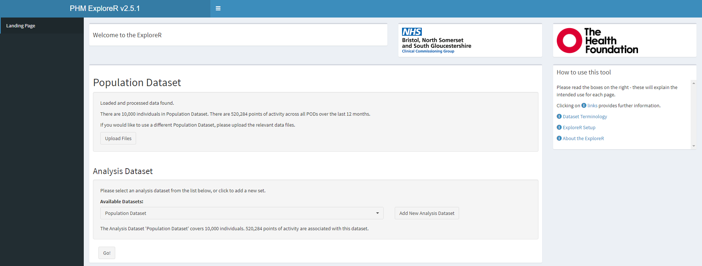
To add your data, click ‘Upload Files’

Slide 4
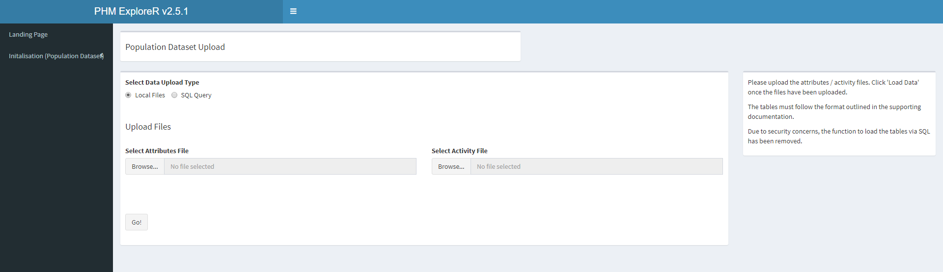
Your will need to provide 2 .rds local files
SQL option has been permanently disable due to a series of executive decisions and concerns over security.

Slide 5
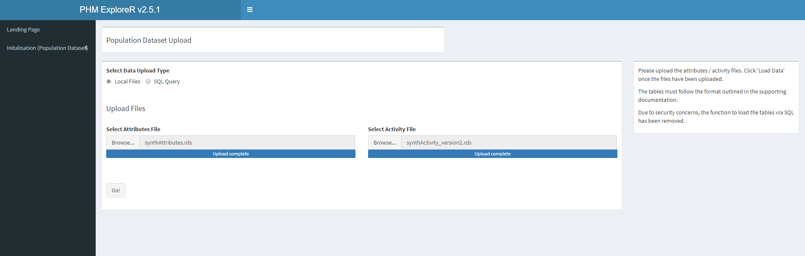
Upload your files
Wait for the files to finish uploading before pressing ‘Go!’.
Once done, press ‘Go!’

Slide 6
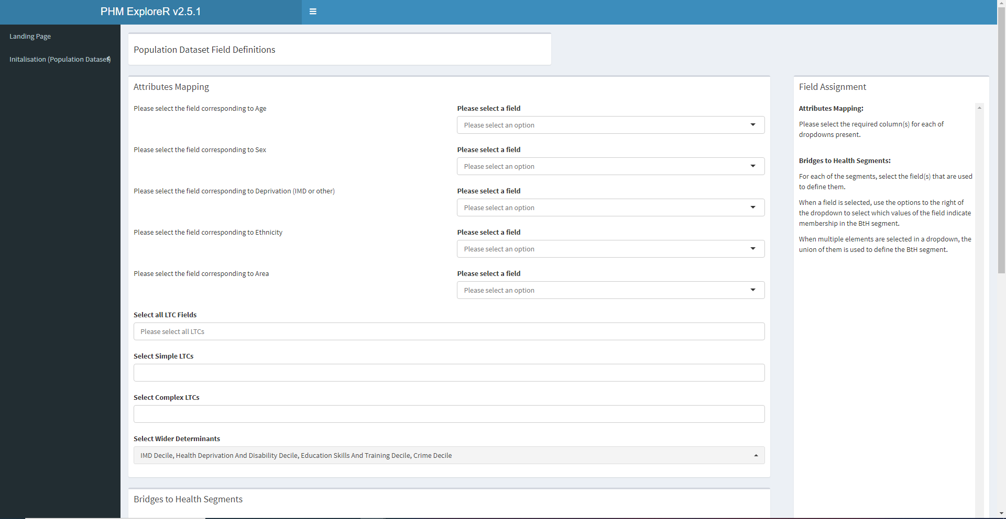
Attribute mapping
Select the fields corresponding to those required.
A field must be selected for each, or it may cause errors.

Slide 7
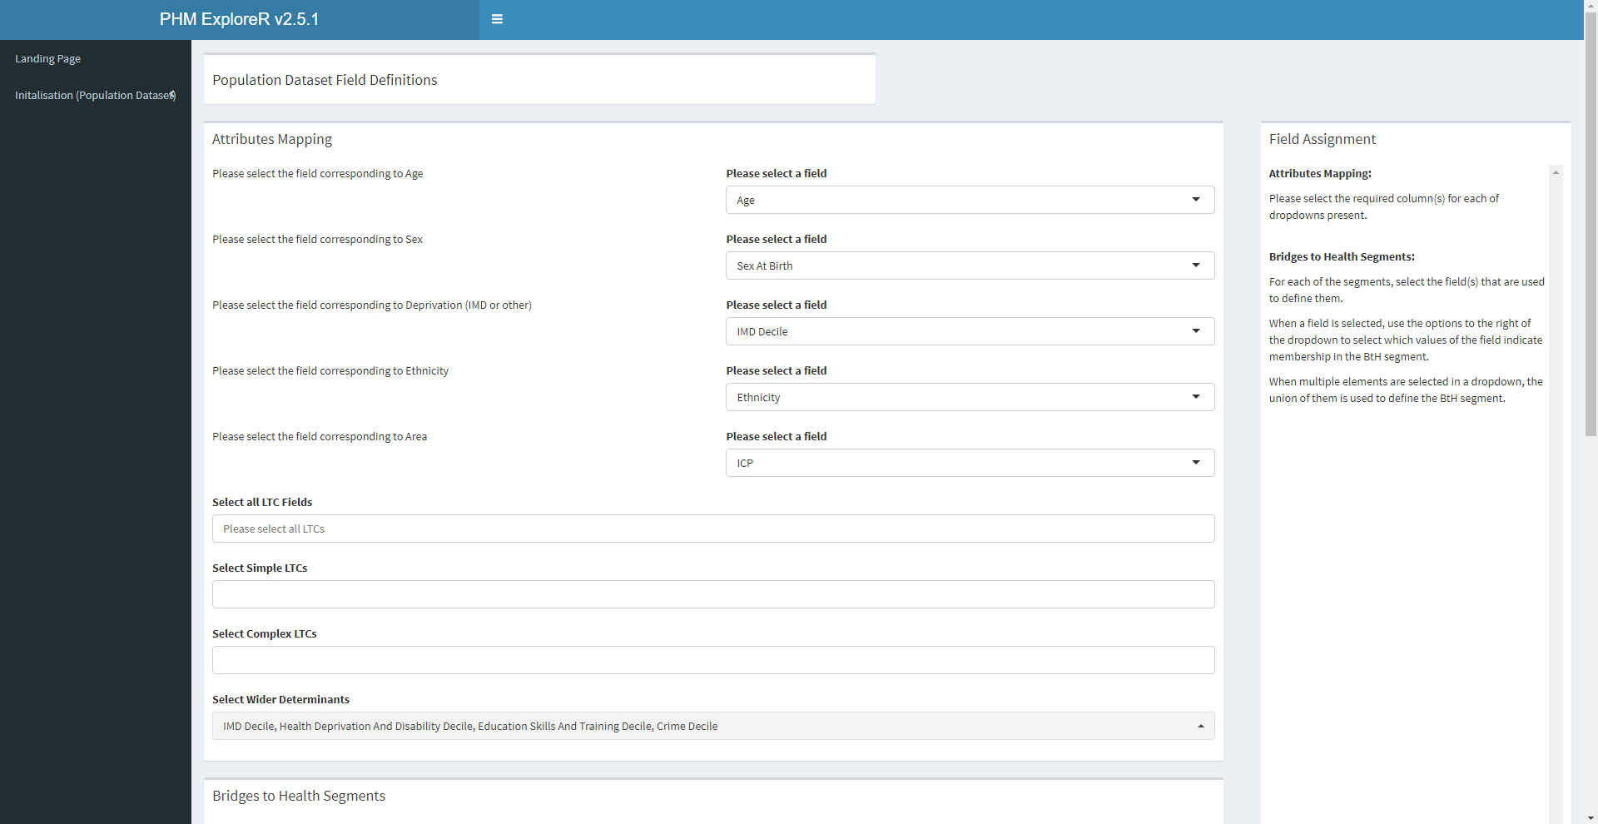
Attribute mapping
Then, select all LTC condition, as well as classify them into simple and complex. At least one option must be selected in each.
Finally, select all wider determinants.

Slide 8
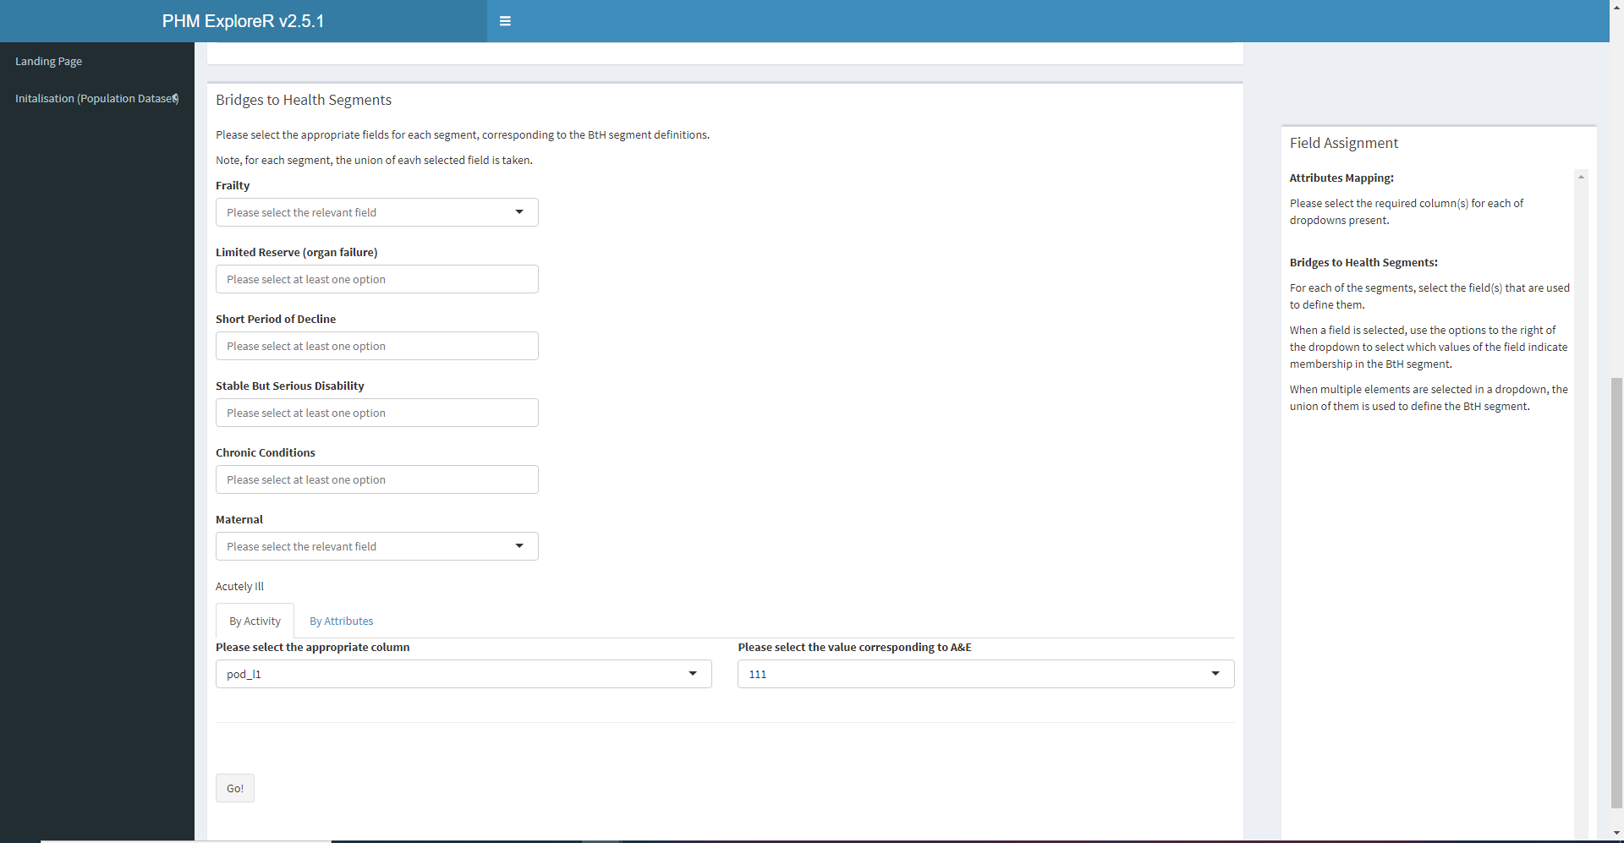
Attribute mapping: Bridges to Health
The Bridges to Health (BtH) segments are optional (can be left blank). This guide covers one possible definition; other systems may use different definitions. It may be preferable to instead include BtH as a clinic.misc field in your data.

Slide 9
Attribute mapping: Bridges to Health
Otherwise, simple definitions can be used to define BtH segments in the ExploreR.

Slide 10
Attribute mapping: Bridges to Health
For each segment, select field(s) that indicate membership. Multiple fields are joined by OR, i.e. if a patient has any of those attributes, they will be placed in that segment.

Slide 11

Attribute mapping: Bridges to Health
Example: frailty segment is defined as severe or moderate frailty.

Slide 12
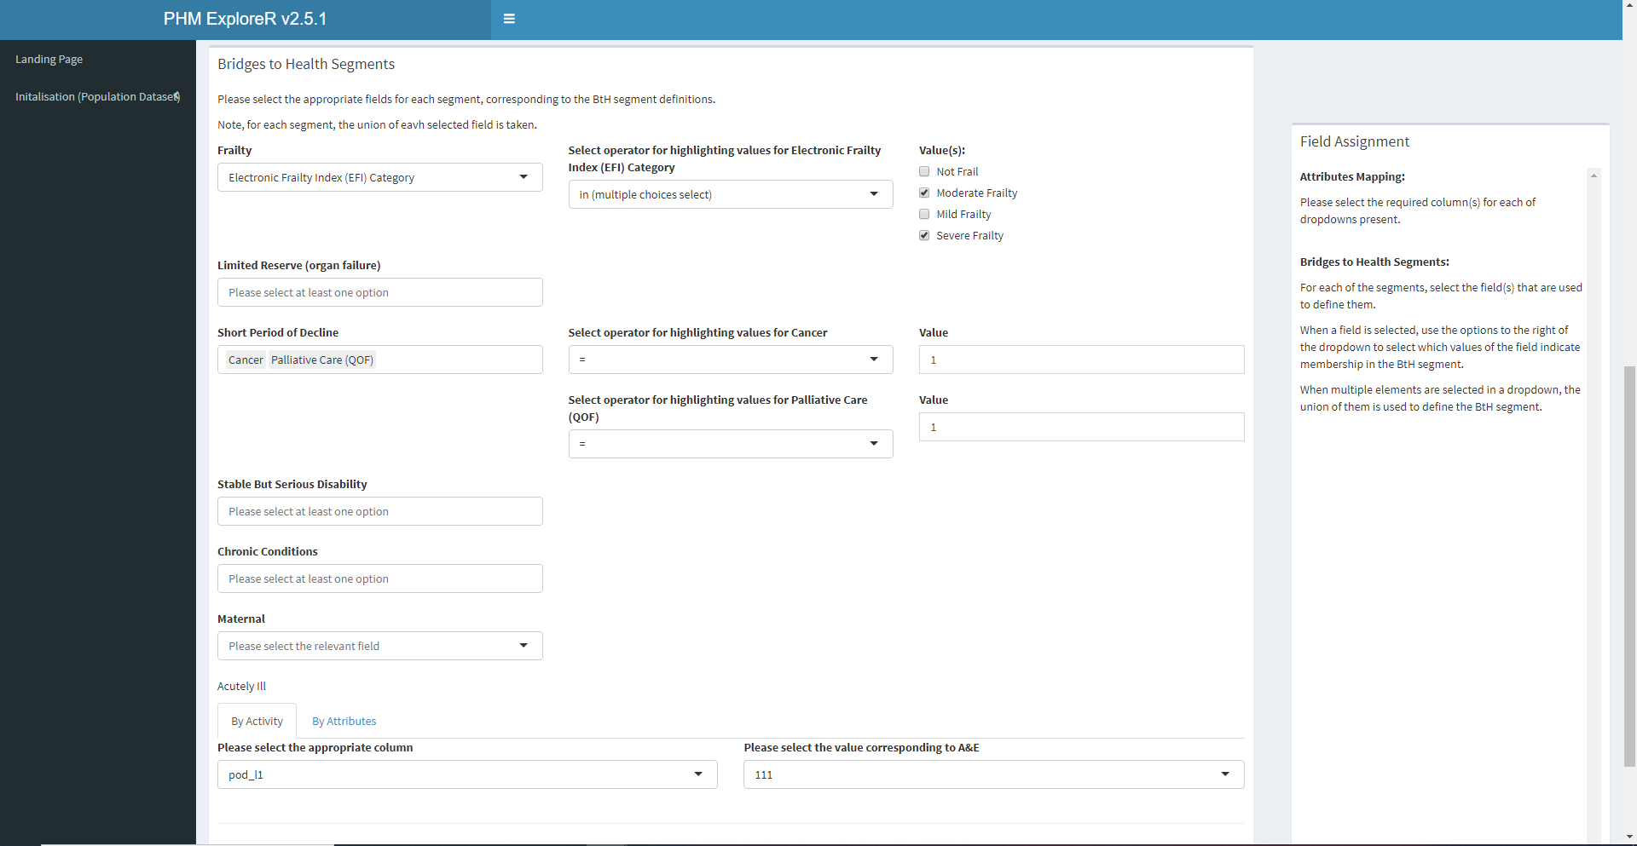
Attribute mapping: Bridges to Health
Example: short period of decline: cancer or palliative care

Slide 13
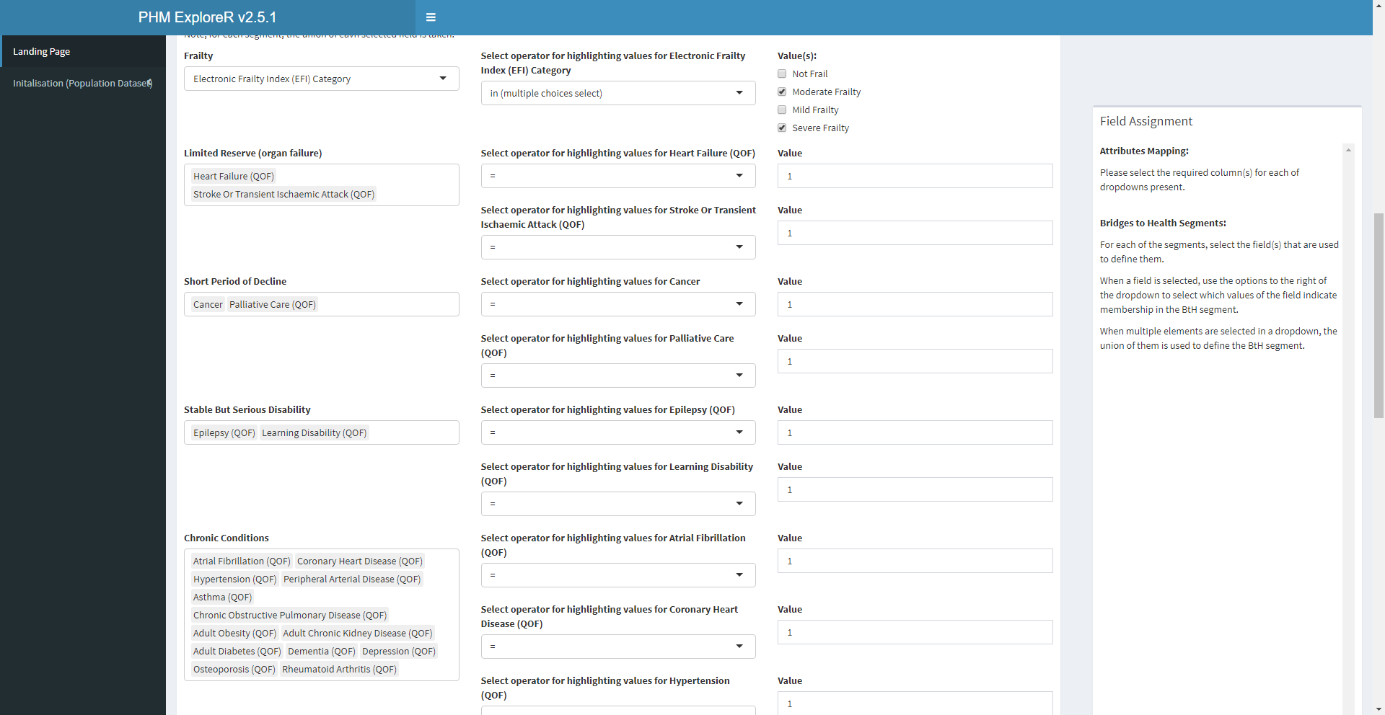
Attribute mapping: Bridges to Health
Summary of basic definition using synthetic dataset part 1

Slide 14
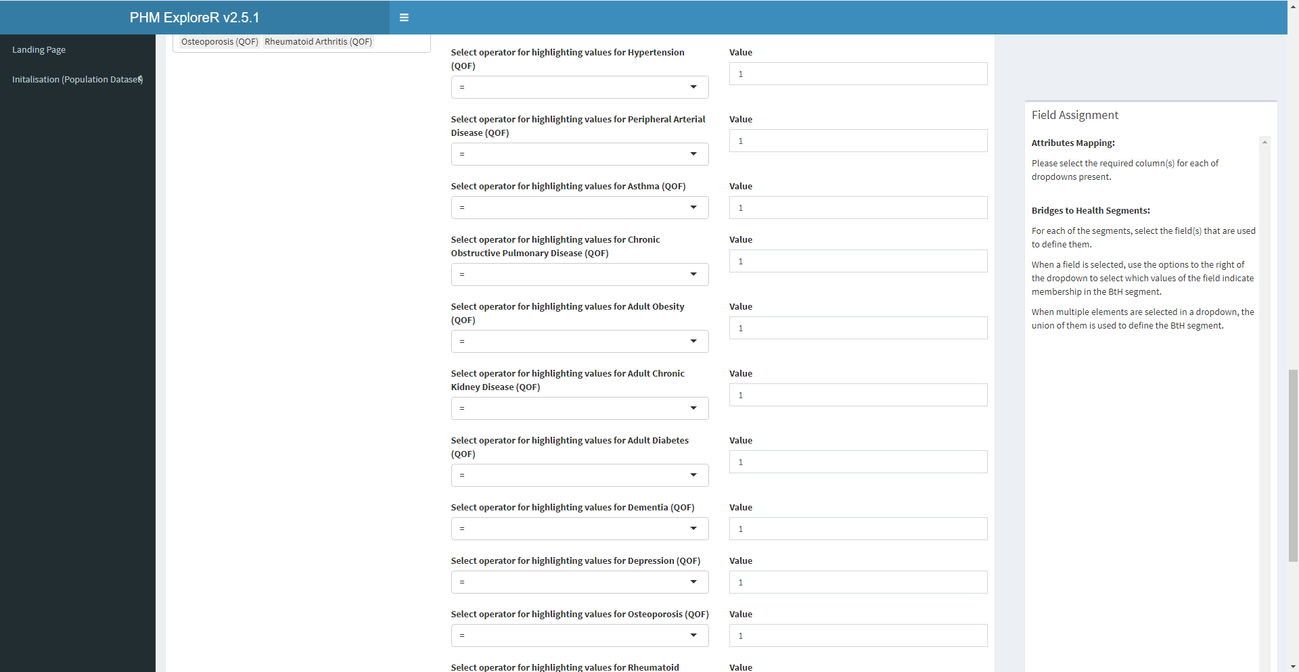
Attribute mapping: Bridges to Health
Summary of basic definition using synthetic dataset part 2

Slide 15
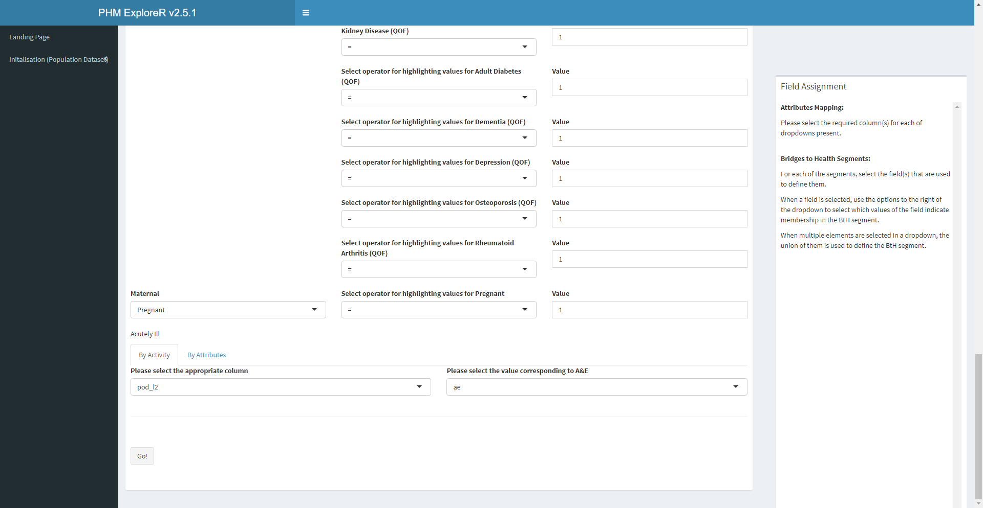
Attribute mapping: Bridges to Health
Summary of basic definition using synthetic dataset part 3

Slide 16

Finally, click ‘Go!’
Once you click, wait for the program to return to the landing page.
It is strongly recommended that you restart once this is done.

Slide 17
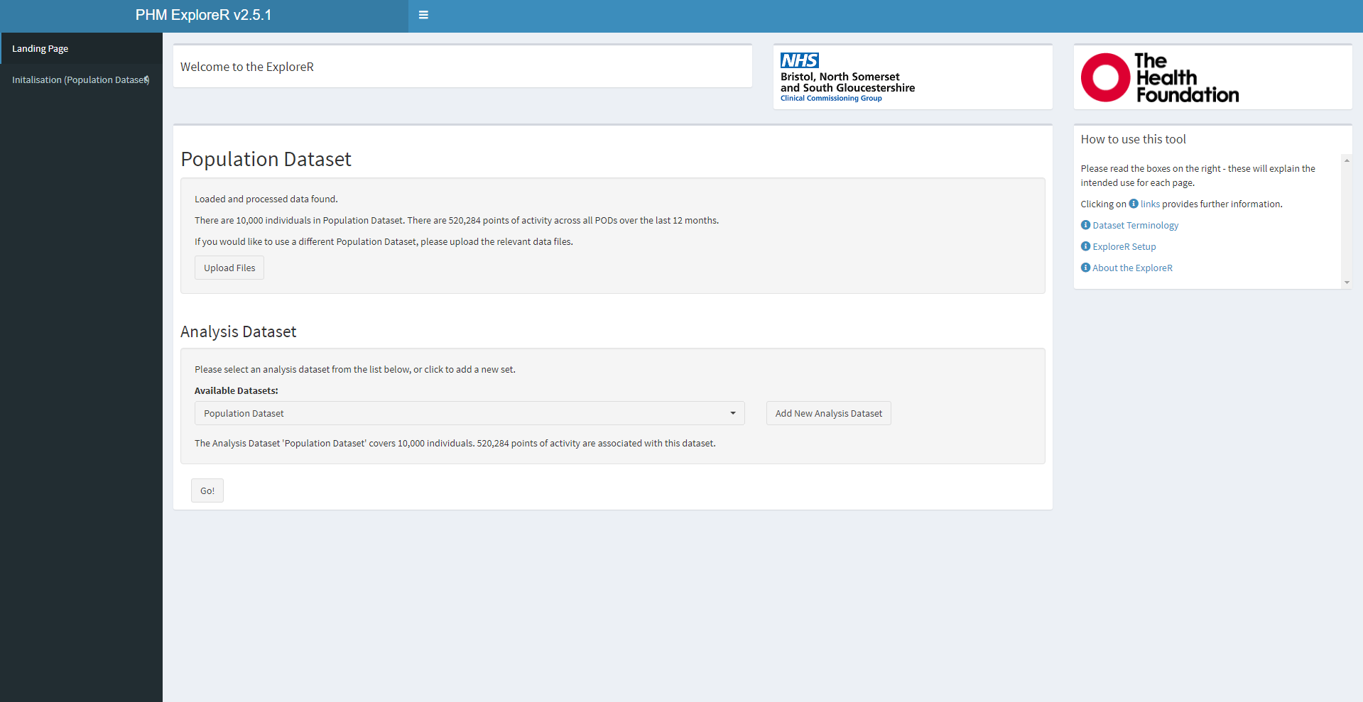
Wait for the program to return to the landing page, then restart.

